Slide 1
Chapter 9: Memory Management
Background
Swapping
Contiguous Allocation
Paging
Segmentation
Segmentation with Paging

Slide 2
Background
Program must be brought into memory and placed within a process for it to be run.
Input queue – collection of processes on the disk that are waiting to be brought into memory to run the program.
User programs go through several steps before being run.

Slide 3
Binding of Instructions and Data to Memory
Address binding of instructions and data to memory addresses can
happen at three different stages.
Compile time: If memory location known a priori, absolute code can be generated; must recompile code if starting location changes.
Load time: Must generate relocatable code if memory location is not known at compile time.
Execution time: Binding delayed until run time if the process can be moved during its execution from one memory segment to another. Need hardware support for address maps (e.g., base and limit registers).

Slide 4
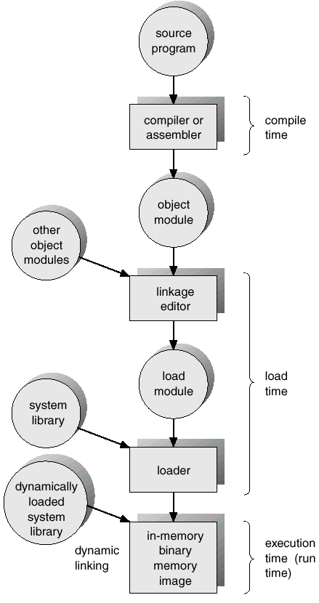
Multistep Processing of a User Program

Slide 5
Logical vs. Physical Address Space
The concept of a logical address space that is bound to a separate physical address space is central to proper memory management.
  Logical address – generated by the CPU; also referred to as virtual address.
  Physical address – address seen by the memory unit.
Logical and physical addresses are the same in compile-time and load-time address-binding schemes; logical (virtual) and physical addresses differ in execution-time address-binding scheme.

Slide 6
Memory-Management Unit (MMU)
Hardware device that maps virtual to physical address.
In MMU scheme, the value in the relocation register is added to every address generated by a user process at the time it is sent to memory.
The user program deals with logical addresses; it never sees the real physical addresses.

Slide 7
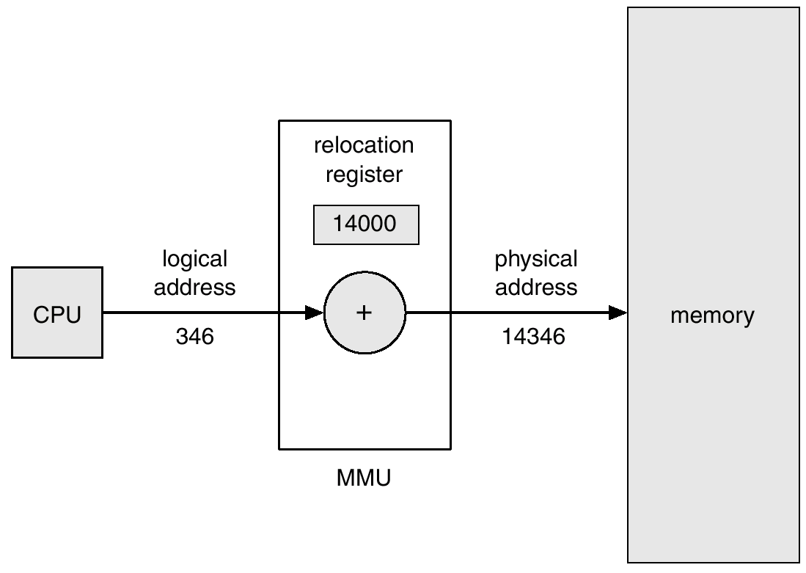
Dynamic relocation using a relocation register

Slide 8
Dynamic Loading
Routine is not loaded until it is called
Better memory-space utilization; unused routine is never loaded.
Useful when large amounts of code are needed to handle infrequently occurring cases.
No special support from the operating system is required implemented through program design.

Slide 9
Dynamic Linking
Linking postponed until execution time.
Small piece of code, stub, used to locate the appropriate memory-resident library routine.
Stub replaces itself with the address of the routine, and executes the routine.
Operating system needed to check if routine is in processes’ memory address.
Dynamic linking is particularly useful for libraries.

Slide 10
Overlays
Keep in memory only those instructions and data that are needed at any given time.
Needed when process is larger than amount of memory allocated to it.
Implemented by user, no special support needed from operating system, programming design of overlay structure is complex

Slide 11
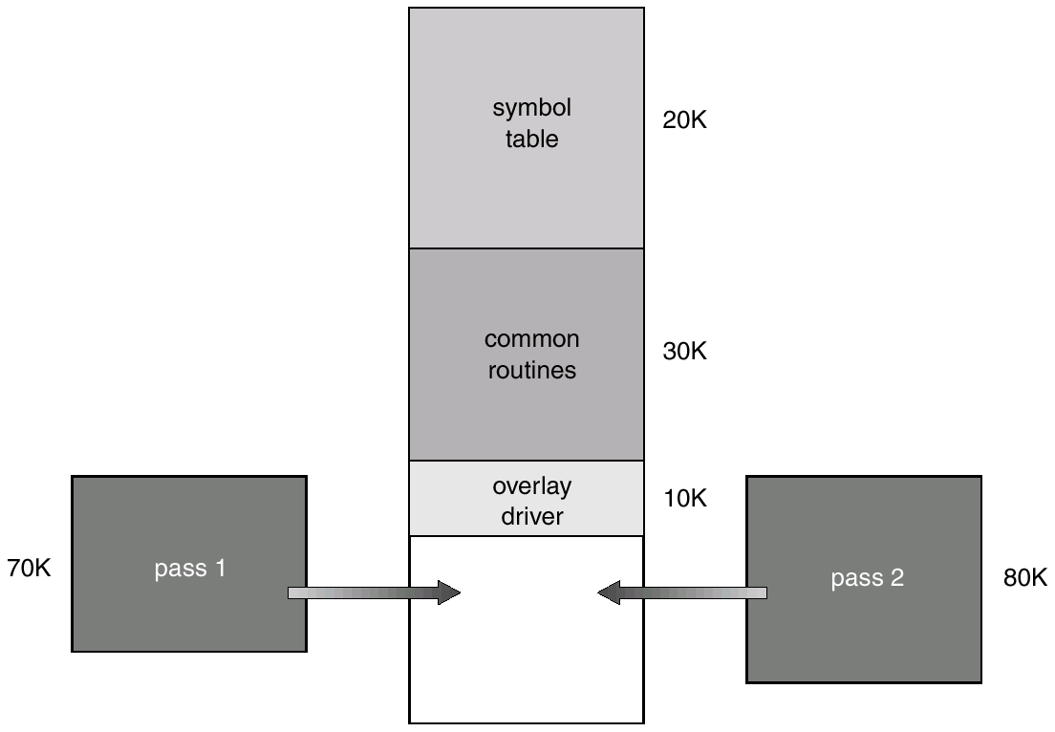
Overlays for a Two-Pass Assembler

Slide 12
Swapping
A process can be swapped temporarily out of memory to a backing store, and then brought back into memory for continued execution.
Backing store – fast disk large enough to accommodate copies of all memory images for all users; must provide direct access to these memory images.
Roll out, roll in – swapping variant used for priority-based scheduling algorithms; lower-priority process is swapped out so higher-priority process can be loaded and executed.
Major part of swap time is transfer time; total transfer time is directly proportional to the amount of memory swapped.
Modified versions of swapping are found on many systems, i.e., UNIX, Linux, and Windows.

Slide 13
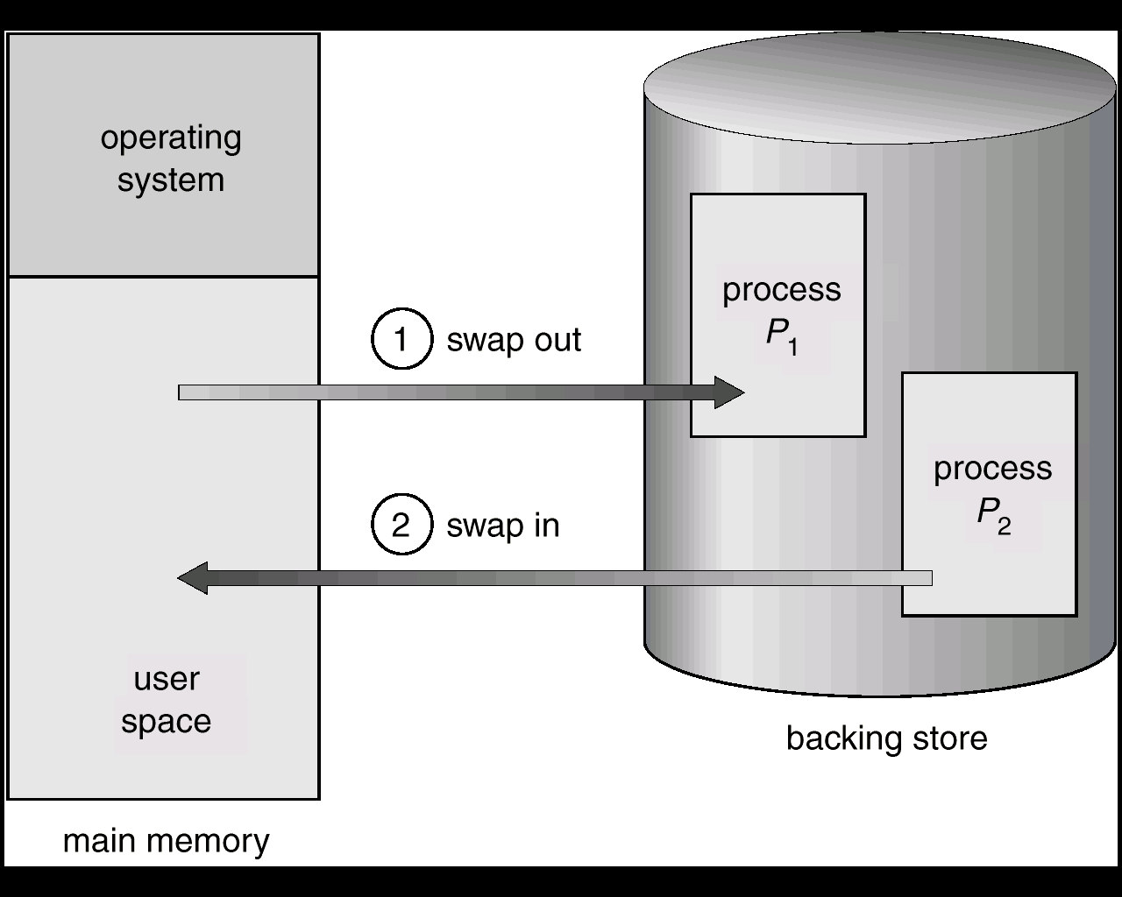
Schematic View of Swapping

Slide 14
Contiguous Allocation
Main memory usually into two partitions:
  Resident operating system, usually held in low memory with interrupt vector.
  User processes then held in high memory.
Single-partition allocation
  Relocation-register scheme used to protect user processes from each other, and from changing operating-system code and data.
  Relocation register contains value of smallest physical address; limit register contains range of logical addresses – each logical address must be less than the limit register.

Slide 15
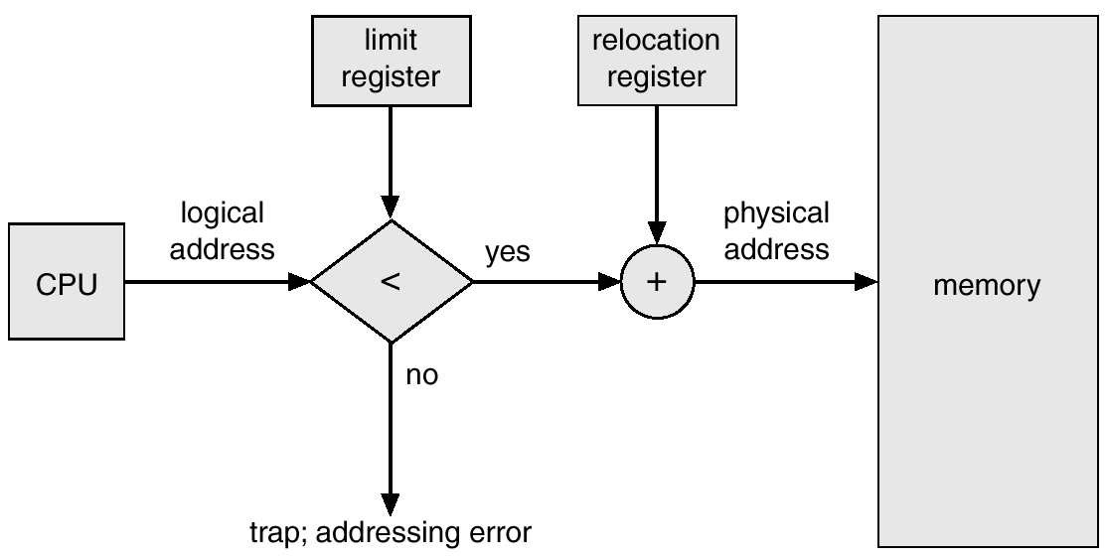
Hardware Support for Relocation and Limit Registers

Slide 16
Contiguous Allocation (Cont.)
Multiple-partition allocation
  Hole – block of available memory; holes of various size are scattered throughout memory.
  When a process arrives, it is allocated memory from a hole large enough to accommodate it.
  Operating system maintains information about:
  a) allocated partitions b) free partitions (hole)
OS
OS
OS
OS
process 5
process 5
process 5
process 5
process 9
process 9
process 8
process 10
process 2
process 2
process 2
process 2

Slide 17
Dynamic Storage-Allocation Problem
How to satisfy a request of size n from a list of free holes.
First-fit: Allocate the first hole that is big enough.
Best-fit: Allocate the smallest hole that is big enough; must search entire list, unless ordered by size. Produces the smallest leftover hole.
Worst-fit: Allocate the largest hole; must also search entire list. Produces the largest leftover hole.
First-fit and best-fit better than worst-fit in terms of speed and storage utilization.

Slide 18
Fragmentation
External Fragmentation – total memory space exists to satisfy a request, but it is not contiguous.
Internal Fragmentation – allocated memory may be slightly larger than requested memory; this size difference is memory internal to a partition, but not being used.
Reduce external fragmentation by compaction
  Shuffle memory contents to place all free memory together in one large block.
  Compaction is possible only if relocation is dynamic, and is done at execution time.
  I/O problem
    Latch job in memory while it is involved in I/O.
    Do I/O only into OS buffers.

Slide 19
Paging
Logical address space of a process can be noncontiguous; process is allocated physical memory whenever the latter is available.
Divide physical memory into fixed-sized blocks called frames (size is power of 2, between 512 bytes and 8192 bytes).
Divide logical memory into blocks of same size called pages.
Keep track of all free frames.
To run a program of size n pages, need to find n free frames and load program.
Set up a page table to translate logical to physical addresses.
Internal fragmentation.

Slide 20
Address Translation Scheme
Address generated by CPU is divided into:
  Page number (p) – used as an index into a page table which contains base address of each page in physical memory.
  Page offset (d) – combined with base address to define the physical memory address that is sent to the memory unit.

Slide 21
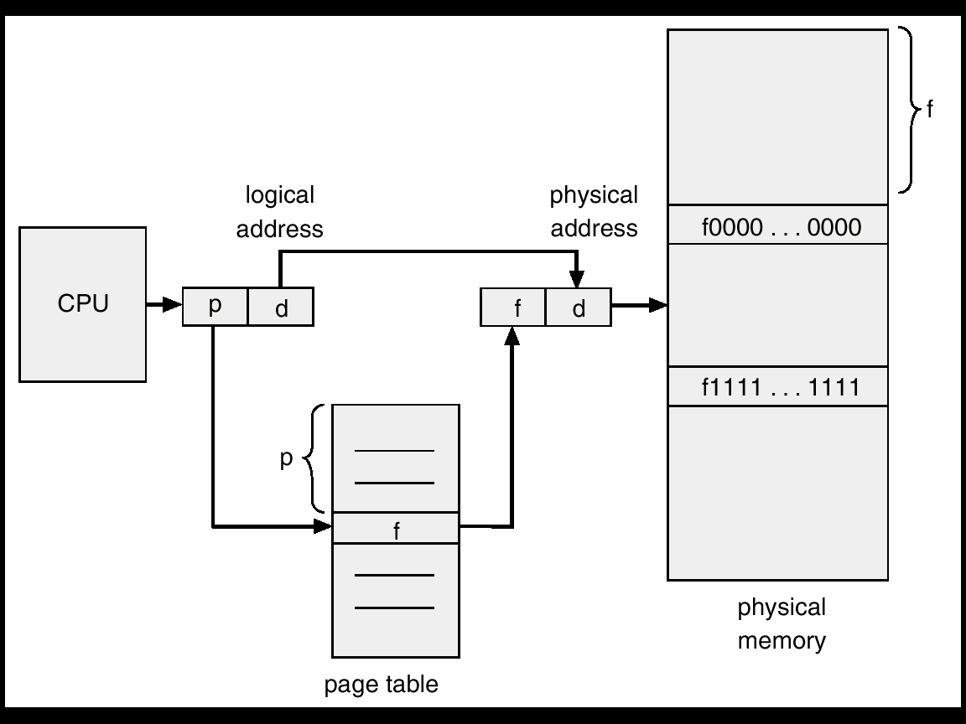
Address Translation Architecture

Slide 22
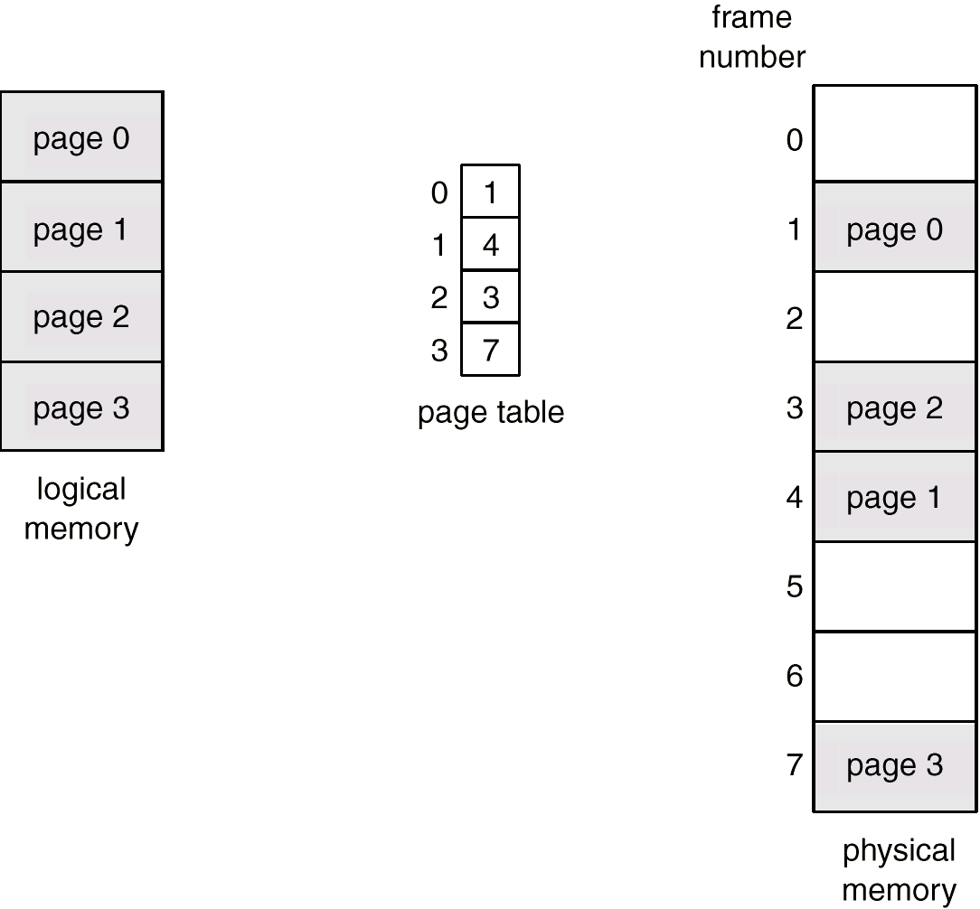
Paging Example

Slide 23
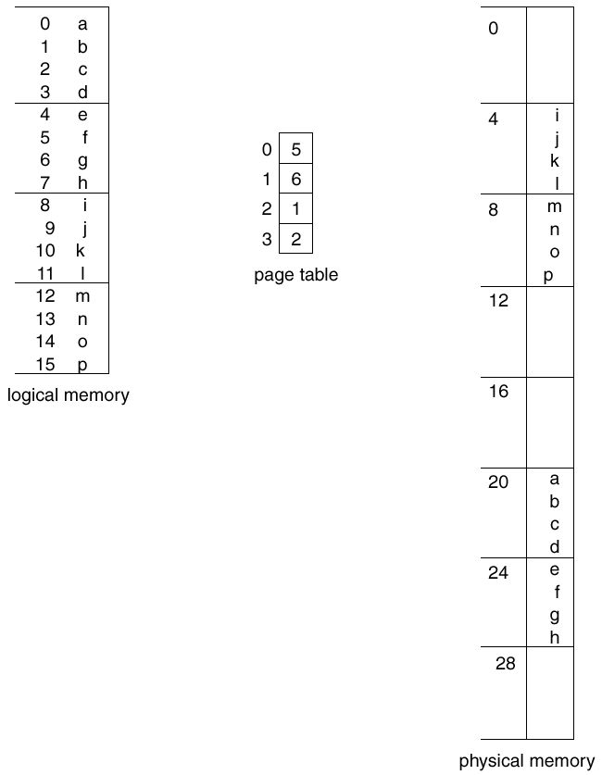
Paging Example

Slide 24
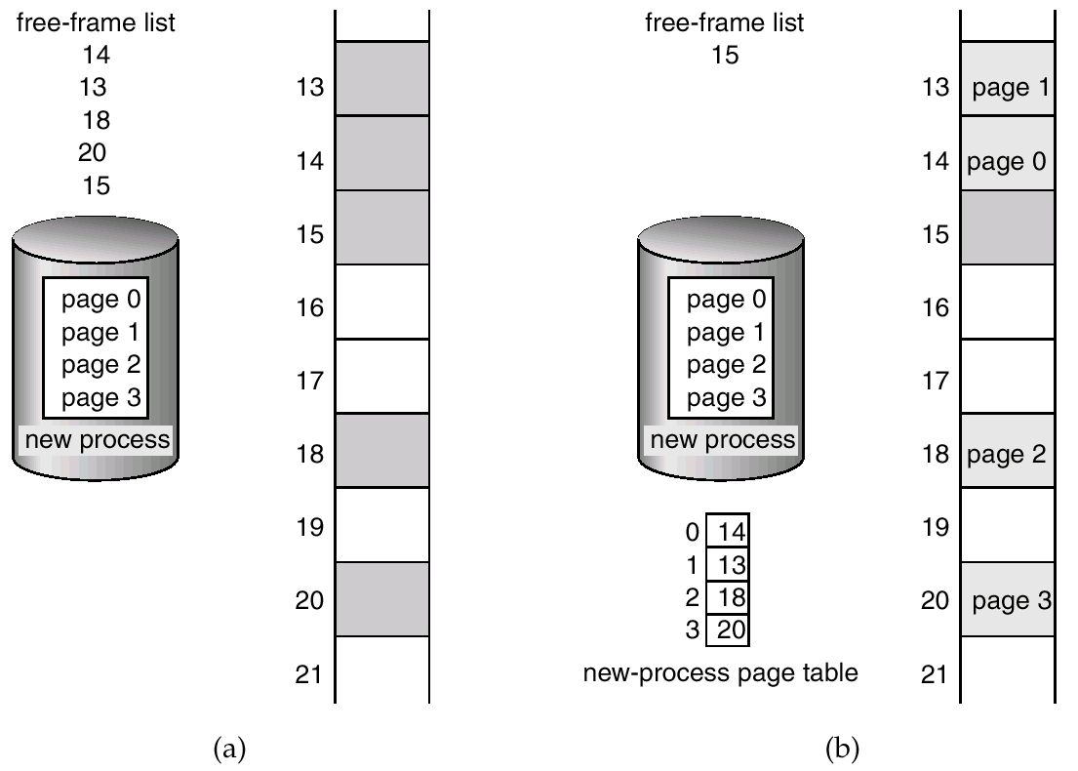
Free Frames
Before allocation
After allocation

Slide 25
Implementation of Page Table
Page table is kept in main memory.
Page-table base register (PTBR) points to the page table.
Page-table length register (PRLR) indicates size of the page table.
In this scheme every data/instruction access requires two memory accesses. One for the page table and one for the data/instruction.
The two memory access problem can be solved by the use of a special fast-lookup hardware cache called associative memory or translation look-aside buffers (TLBs)

Slide 26
Associative Memory
Associative memory – parallel search
Address translation (A´, A´´)
  If A´ is in associative register, get frame # out.
  Otherwise get frame # from page table in memory
Page #
Frame #

Slide 27
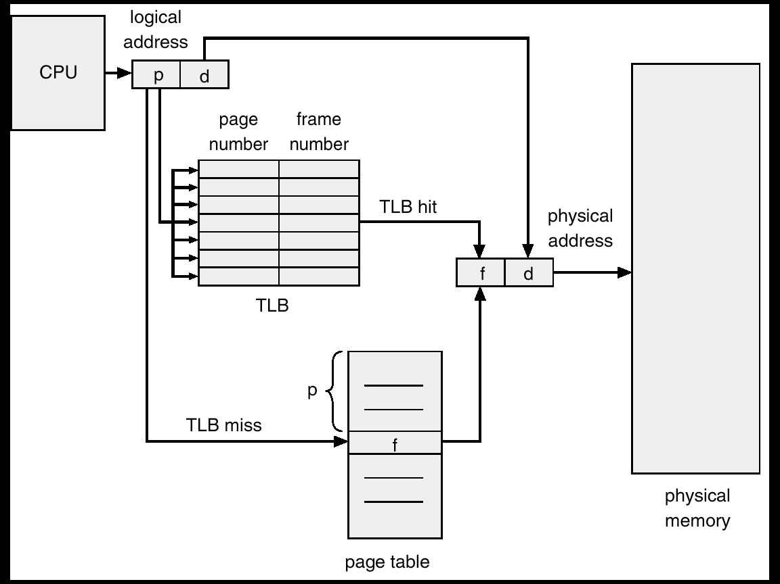
Paging Hardware With TLB

Slide 28
Effective Access Time
Associative Lookup = ε time unit
Assume memory cycle time is 1 microsecond
Hit ratio – percentage of times that a page number is found in the associative registers; ration related to number of associative registers.
Hit ratio = α
Effective Access Time (EAT)
EAT = (1 + ε) α + (2 + ε)(1 – α)
= 2 + ε – α

Slide 29
Memory Protection
Memory protection implemented by associating protection bit with each frame.
Valid-invalid bit attached to each entry in the page table:
  “valid” indicates that the associated page is in the process’ logical address space, and is thus a legal page.
  “invalid” indicates that the page is not in the process’ logical address space.

Slide 30
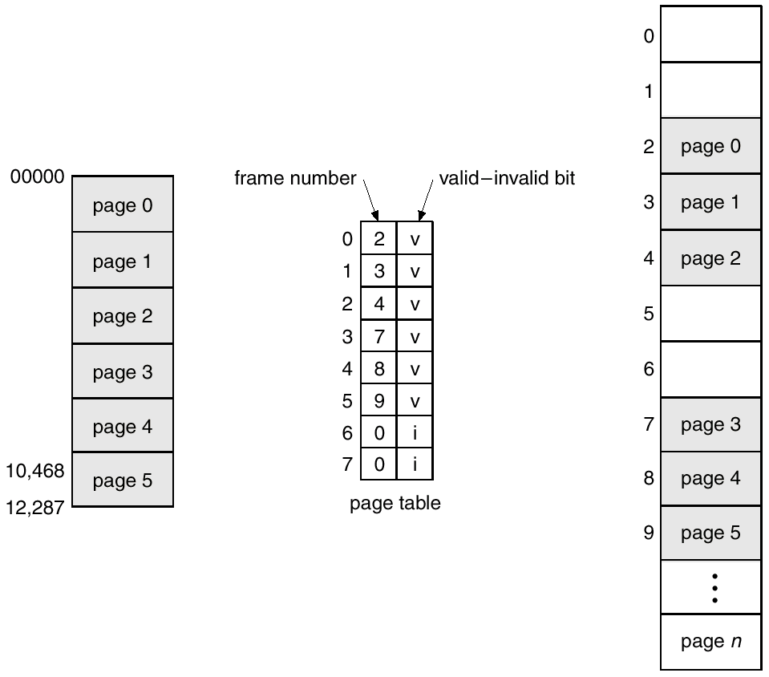
Valid (v) or Invalid (i) Bit In A Page Table

Slide 31
Page Table Structure
Hierarchical Paging
Hashed Page Tables
Inverted Page Tables

Slide 32
Hierarchical Page Tables
Break up the logical address space into multiple page tables.
A simple technique is a two-level page table.

Slide 33
Two-Level Paging Example
A logical address (on 32-bit machine with 4K page size) is divided into:
  a page number consisting of 20 bits.
  a page offset consisting of 12 bits.
Since the page table is paged, the page number is further divided into:
  a 10-bit page number.
  a 10-bit page offset.
Thus, a logical address is as follows:
where p_{i} is an index into the outer page table, and p₂ is the displacement within the page of the outer page table.
page number
page offset
p_{i}
p₂
d
10
10
12

Slide 34
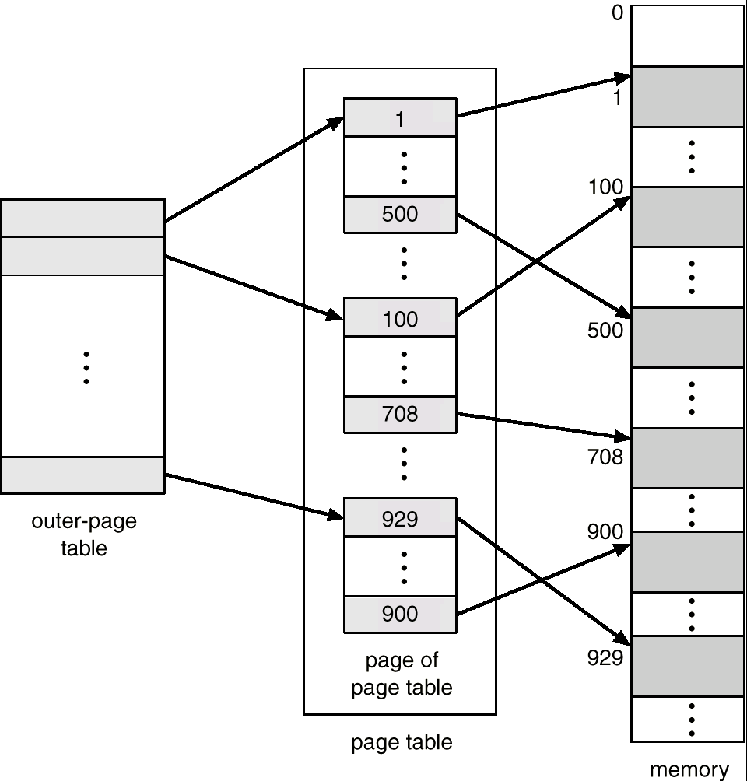
Two-Level Page-Table Scheme

Slide 35
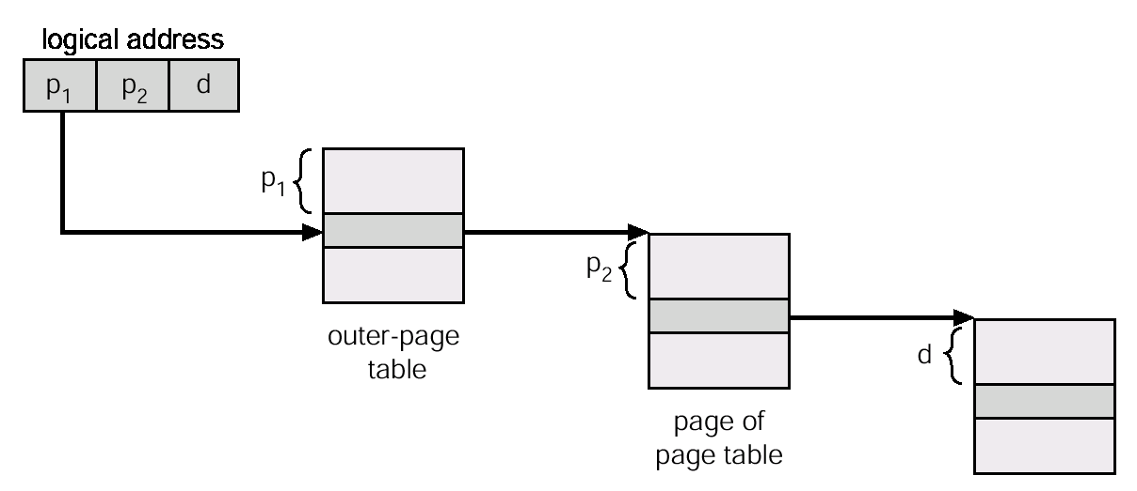
Address-Translation Scheme
Address-translation scheme for a two-level 32-bit paging architecture

Slide 36
Hashed Page Tables
Common in address spaces > 32 bits.
The virtual page number is hashed into a page table. This page table contains a chain of elements hashing to the same location.
Virtual page numbers are compared in this chain searching for a match. If a match is found, the corresponding physical frame is extracted.

Slide 37
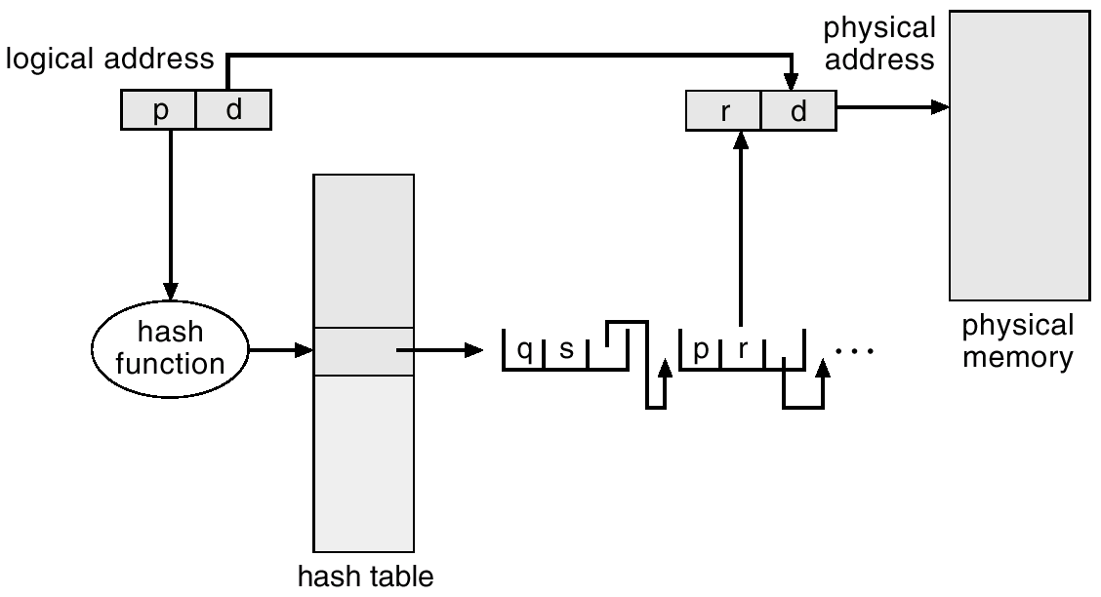
Hashed Page Table

Slide 38
Inverted Page Table
One entry for each real page of memory.
Entry consists of the virtual address of the page stored in that real memory location, with information about the process that owns that page.
Decreases memory needed to store each page table, but increases time needed to search the table when a page reference occurs.
Use hash table to limit the search to one — or at most a few — page-table entries.

Slide 39
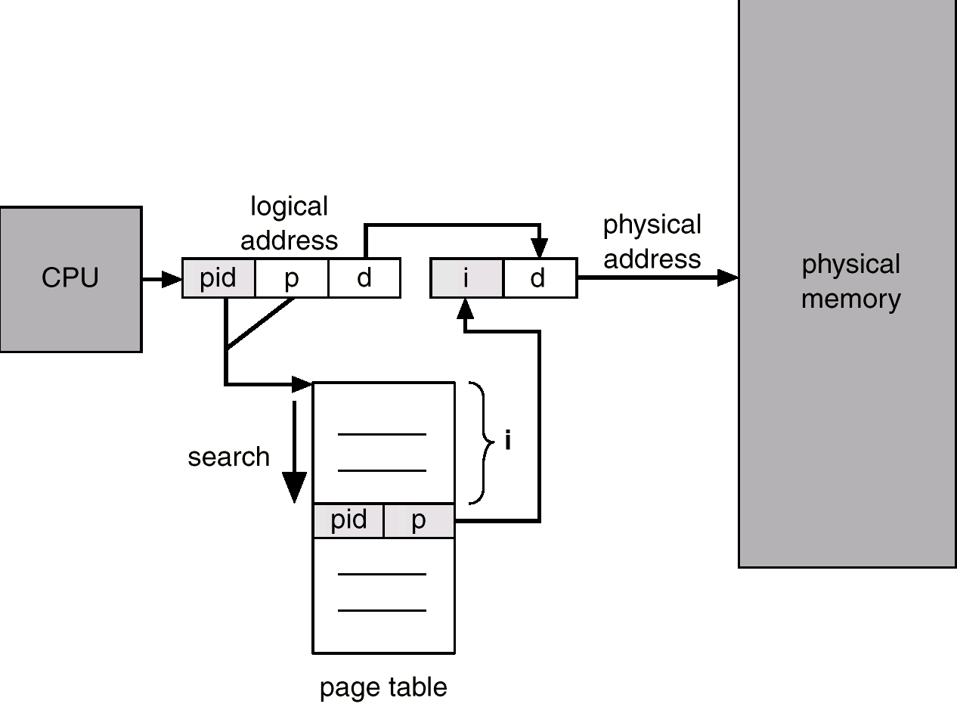
Inverted Page Table Architecture

Slide 40
Shared Pages
Shared code
  One copy of read-only (reentrant) code shared among processes (i.e., text editors, compilers, window systems).
  Shared code must appear in same location in the logical address space of all processes.
Private code and data
  Each process keeps a separate copy of the code and data.
  The pages for the private code and data can appear anywhere in the logical address space.

Slide 41
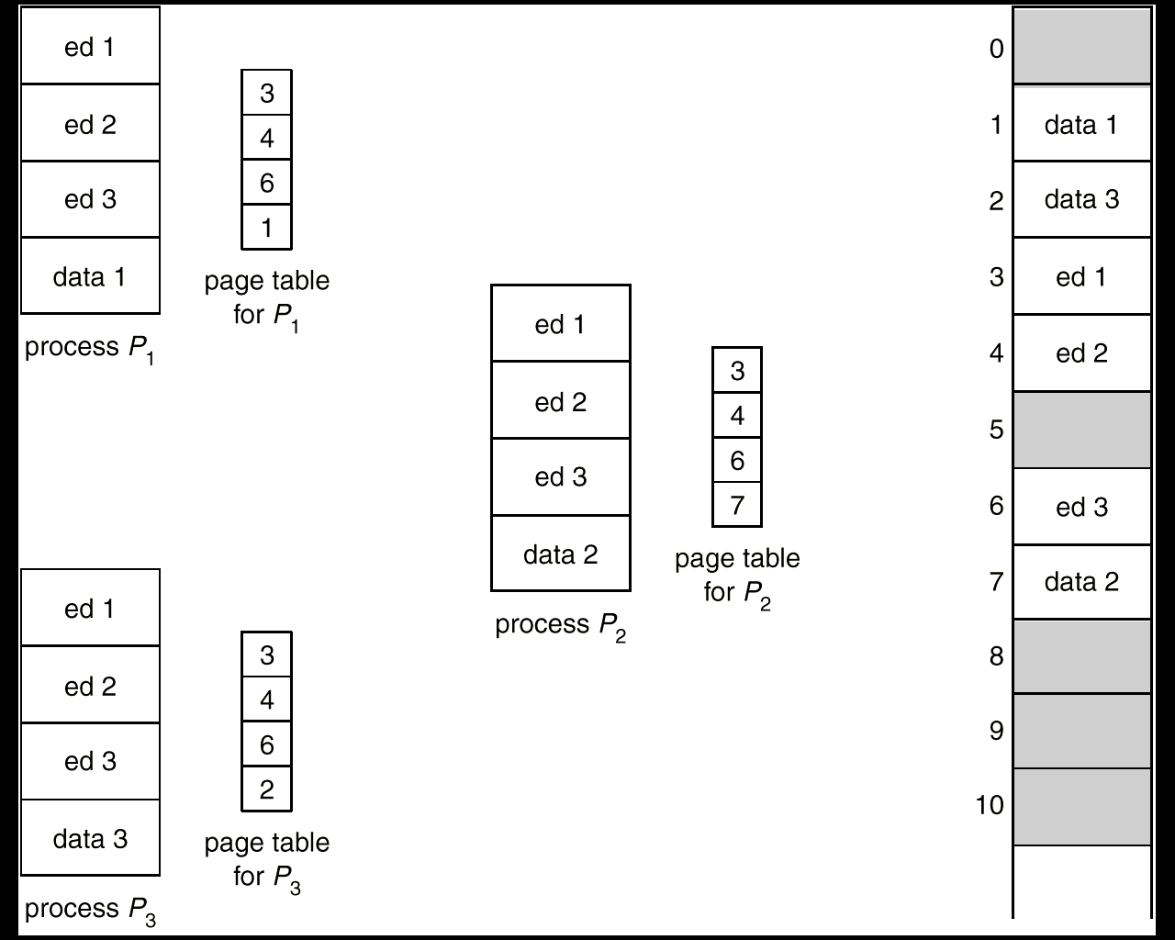
Shared Pages Example

Slide 42
Segmentation
Memory-management scheme that supports user view of memory.
A program is a collection of segments. A segment is a logical unit such as:
main program,
procedure,
function,
method,
object,
local variables, global variables,
common block,
stack,
symbol table, arrays

Slide 43
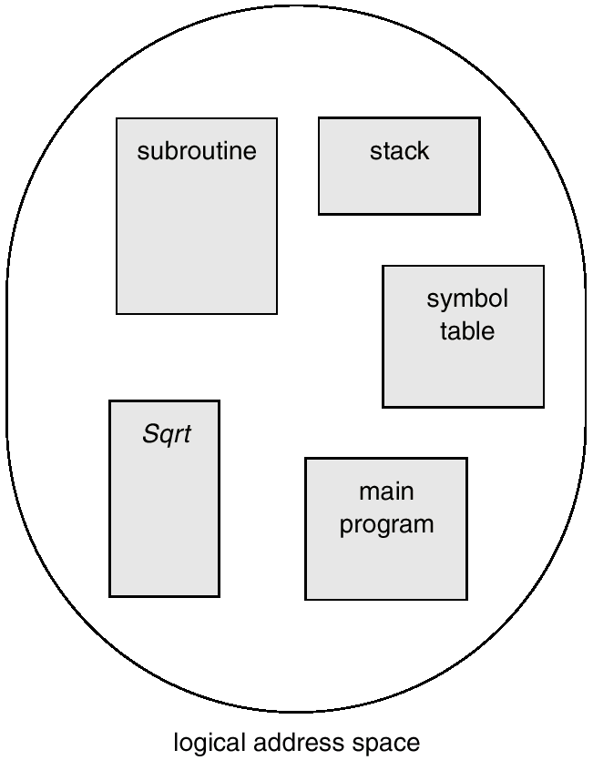
User’s View of a Program

Slide 44
Logical View of Segmentation
1
1
4
2
3
4
2
3
user space
physical memory space

Slide 45
Segmentation Architecture
Logical address consists of a two tuple:
<segment-number, offset>,
Segment table – maps two-dimensional physical addresses; each table entry has:
  base – contains the starting physical address where the segments reside in memory.
  limit – specifies the length of the segment.
Segment-table base register (STBR) points to the segment table’s location in memory.
Segment-table length register (STLR) indicates number of segments used by a program;
segment number s is legal if s < STLR.

Slide 46
Segmentation Architecture (Cont.)
Relocation.
  dynamic
  by segment table
Sharing.
  shared segments
  same segment number
Allocation.
  first fit/best fit
  external fragmentation

Slide 47
Segmentation Architecture (Cont.)
Protection. With each entry in segment table associate:
  validation bit = 0 ⇒ illegal segment
  read/write/execute privileges
Protection bits associated with segments; code sharing occurs at segment level.
Since segments vary in length, memory allocation is a dynamic storage-allocation problem.
A segmentation example is shown in the following diagram

Slide 48
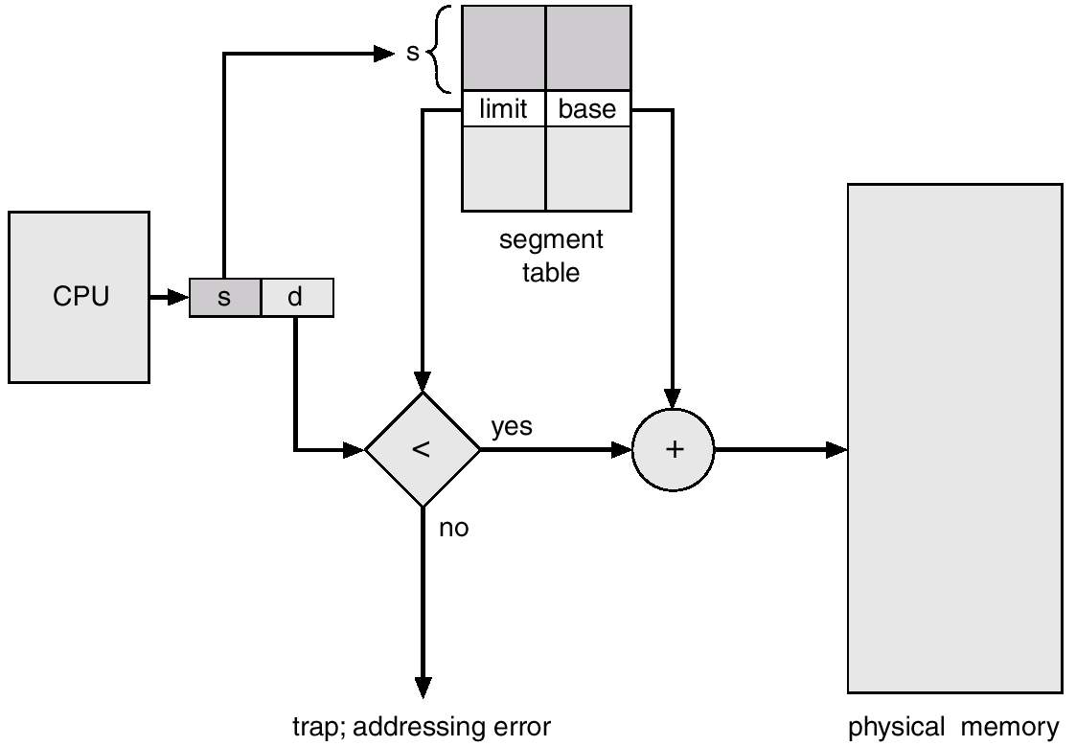
Segmentation Hardware

Slide 49
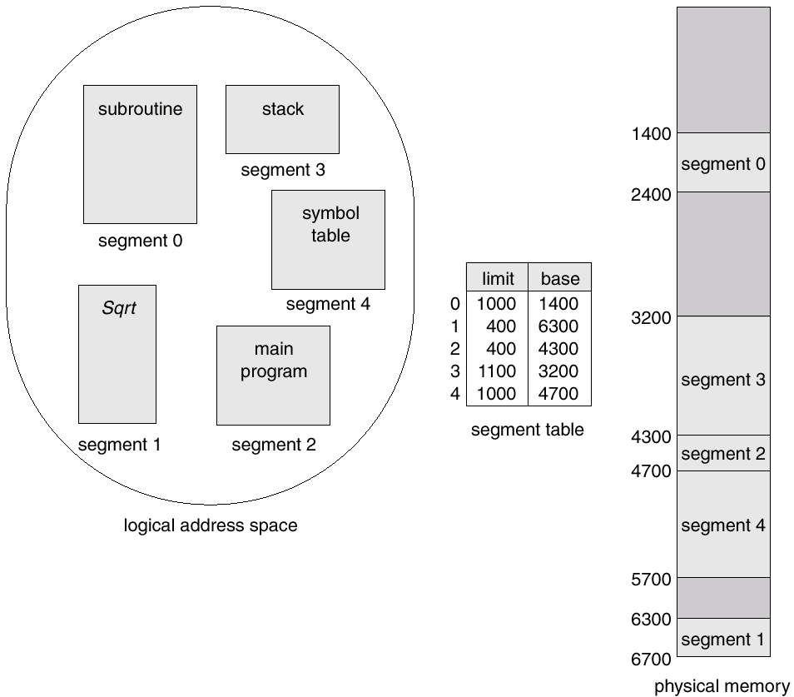
Example of Segmentation

Slide 50
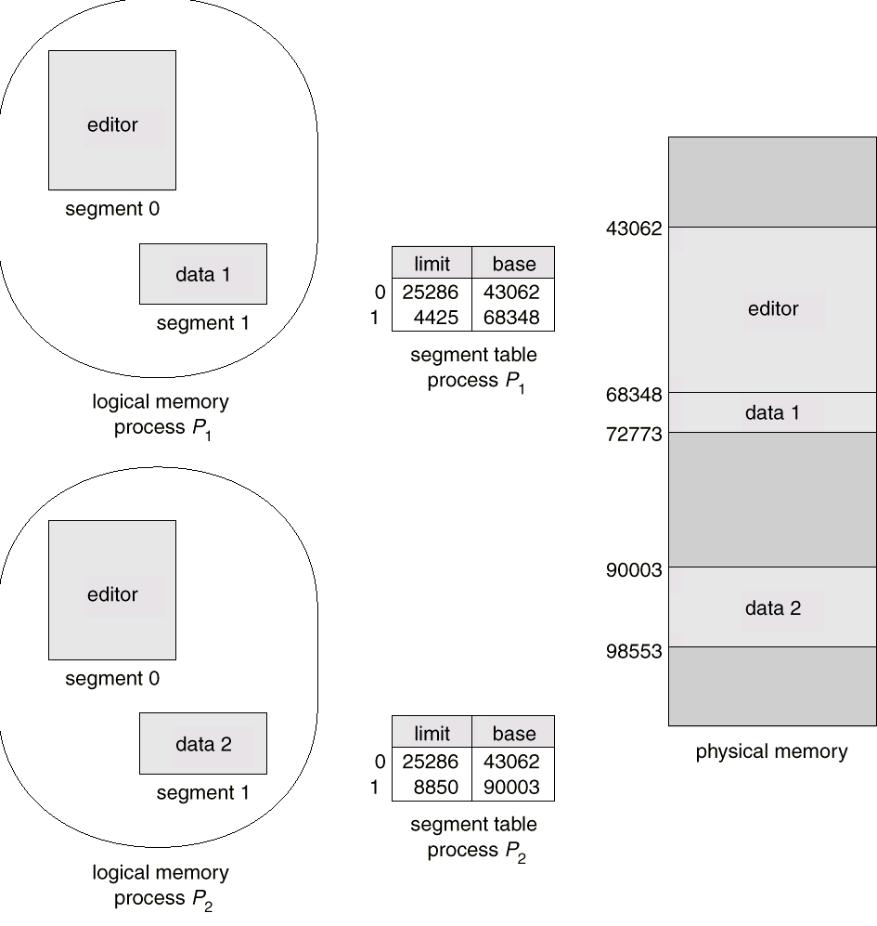
Sharing of Segments

Slide 51
Segmentation with Paging – MULTICS
The MULTICS system solved problems of external fragmentation and lengthy search times by paging the segments.
Solution differs from pure segmentation in that the segment-table entry contains not the base address of the segment, but rather the base address of a page table for this segment.

Slide 52
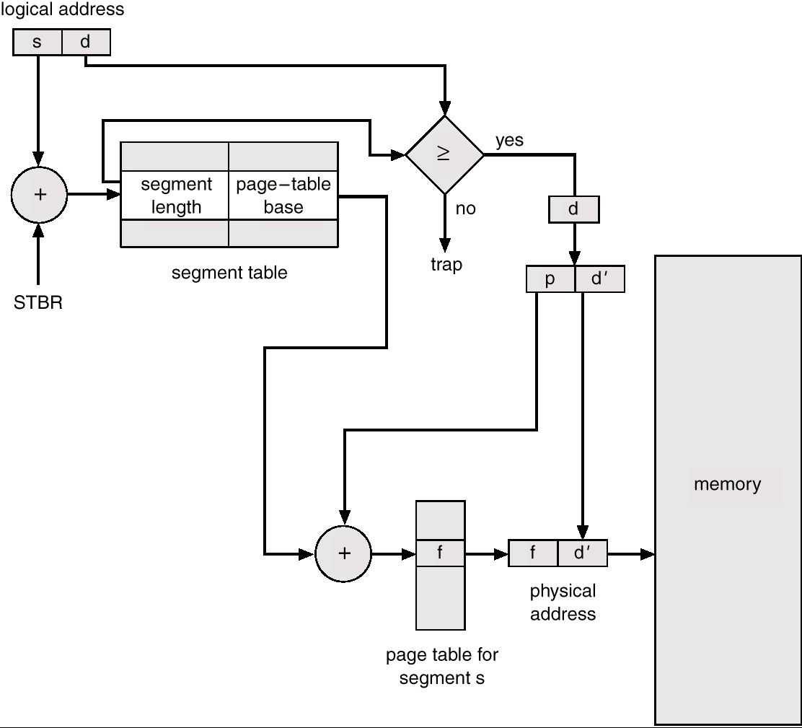
MULTICS Address Translation Scheme

Slide 53
Segmentation with Paging – Intel 386
As shown in the following diagram, the Intel 386 uses segmentation with paging for memory management with a two-level paging scheme.

Slide 54
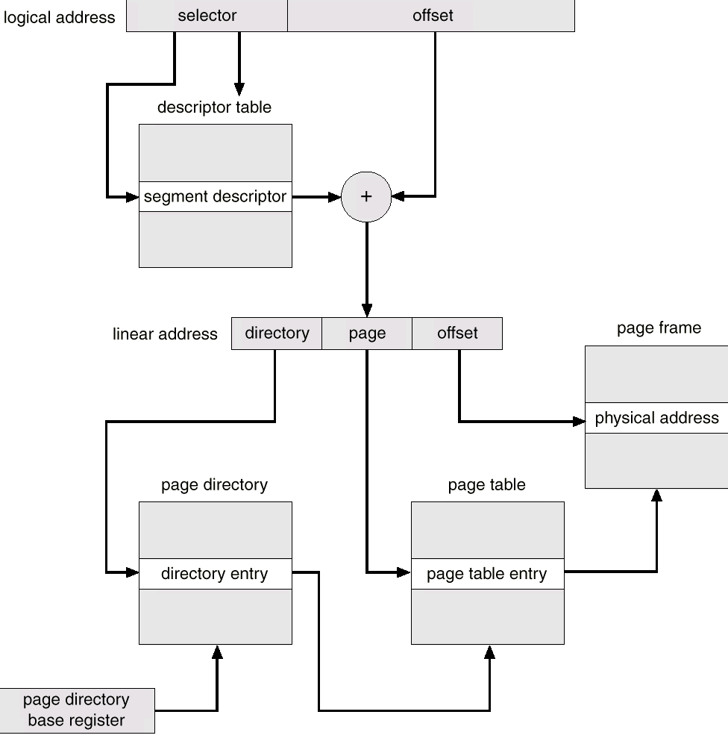
Intel 30386 Address Translation

